Slide 1




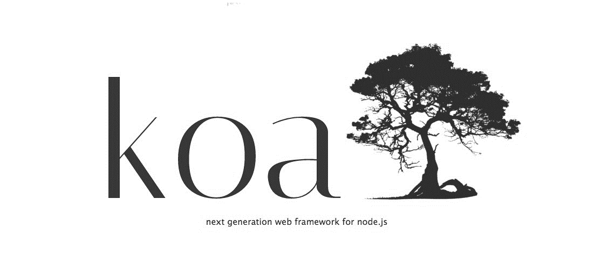

List of Route Management Frameworks for AWS Lambda & NodeJS
Notes:
Good morning API friends. Welcome to my presentation about Serverless APIs. I hope that by the end of it, we would have more serverless ninjas across the globe.

